Slide 1
Hosting a Conference for Families!
Sarah Jecks, M.S.Ed. Silvis School District#34
Debbie Lee, Ed.D. Western Illinois University

Slide 2
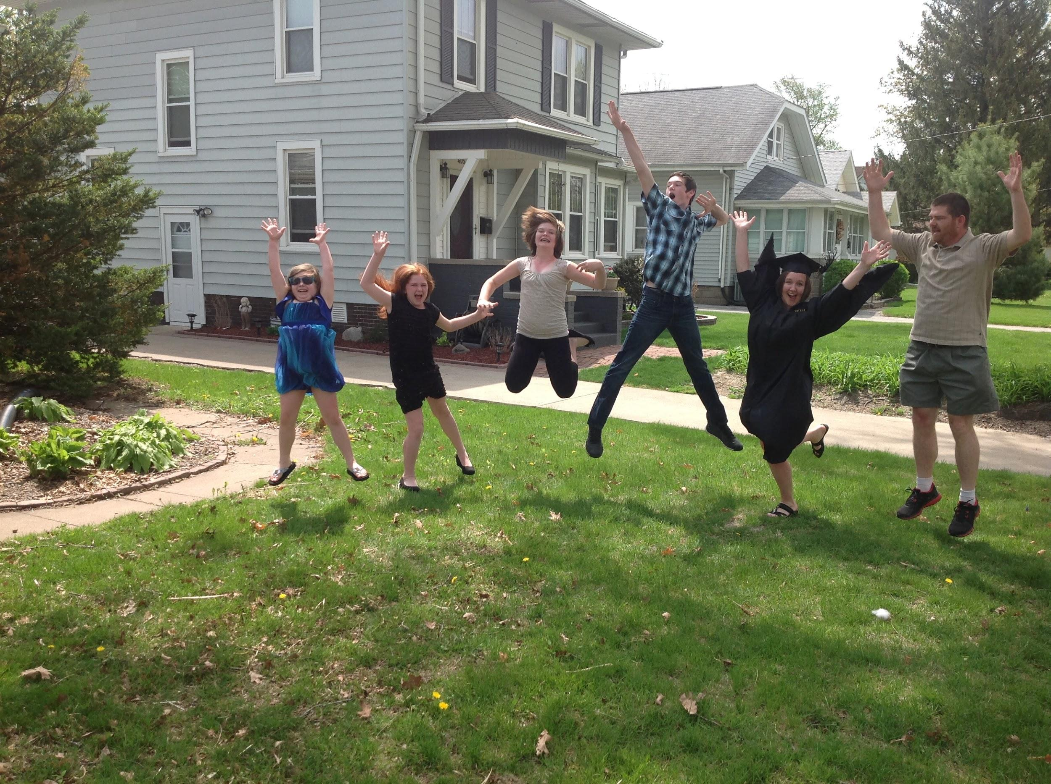
GRAD PROJECT…….

Slide 3
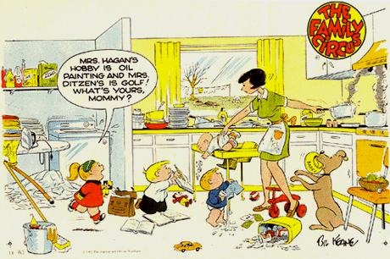
Frazzled!

Slide 4
Who will we serve?
Silvis SD#34
Hampton
SD#29
East Moline SD#37
United Township
High School
Colona SD#190
Carbon Cliff SD#36

Slide 5
When?
Saturday, February 7th!
George O. Barr Elementary
8:30a.m.-Noon

Slide 6
Planning a Successful Family Conference

Slide 7
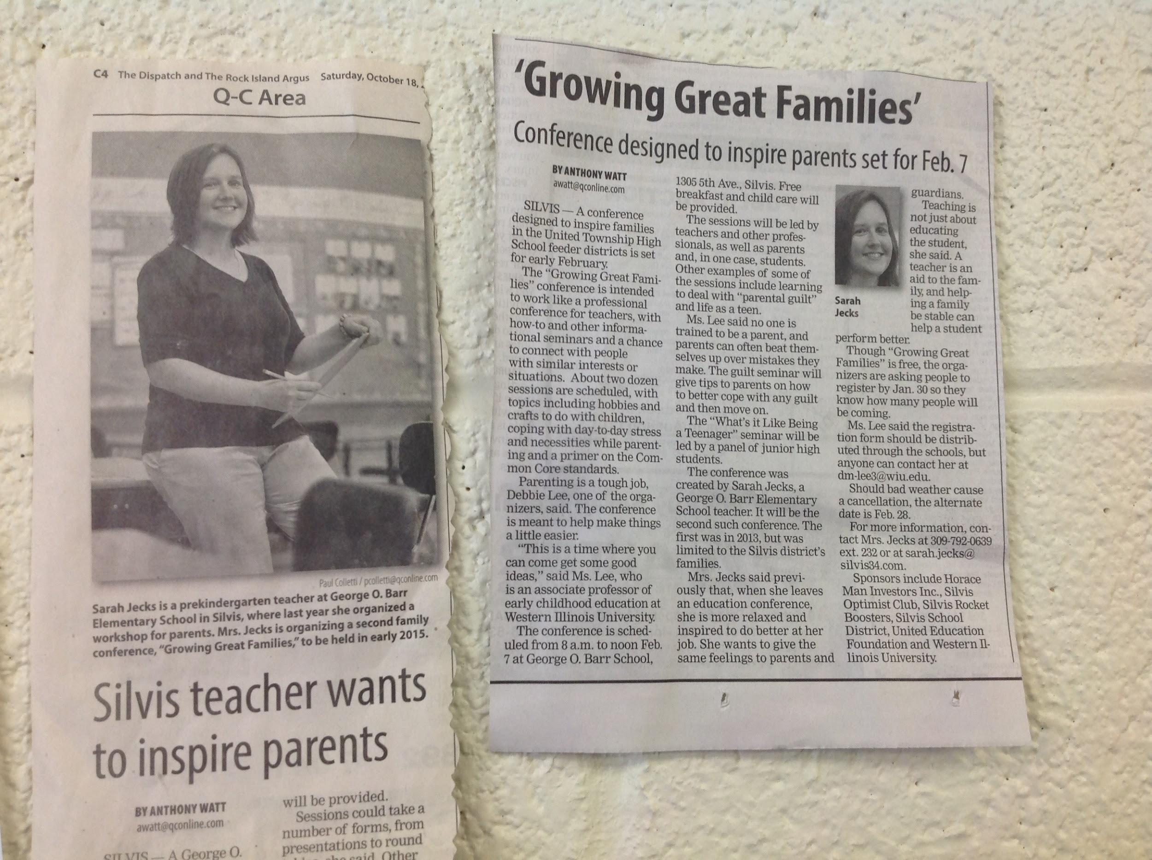
Build a Committee
Advertise to gain members
Choose date
Gather ideas
Create a Planning Worksheet
Work backwards
Snacks are always good!

Slide 8
Save the Date!
Growing Great Families Conference
for ALL families in the
United Township Feeder Schools!
SATURDAY, FEBRUARY 7TH
8:30-12:00
George O. Barr Elementary
1305 5th Ave.
Silvis, IL 61282
*Free
*Child care provided
*Breakfast served

Slide 9
Workshops and Presenters
What topics do you want?
What does the community need?
Who do you know?
Do you want a keynote?
Presenter Application
Presenter Notification Letter

Slide 10
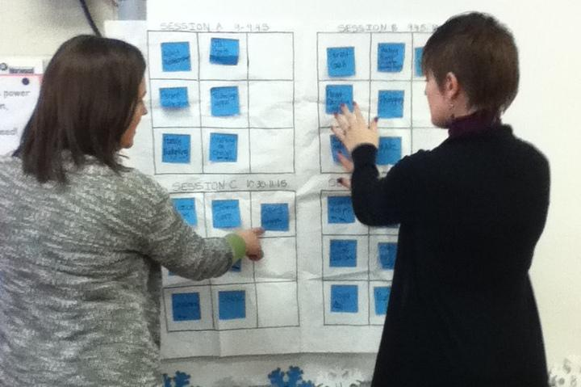
Building the Conference

Slide 11
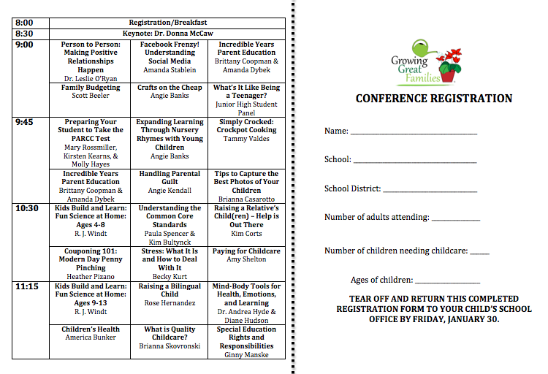
Conference
Flyer

Slide 12
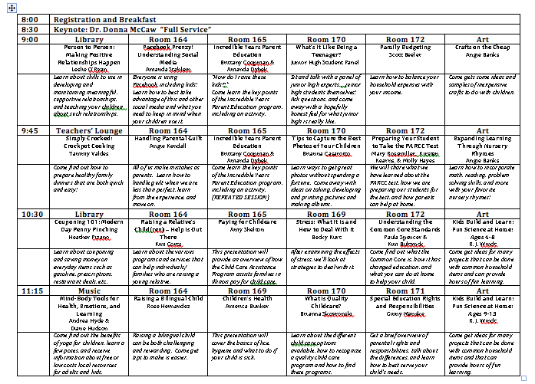
Conference Program

Slide 13
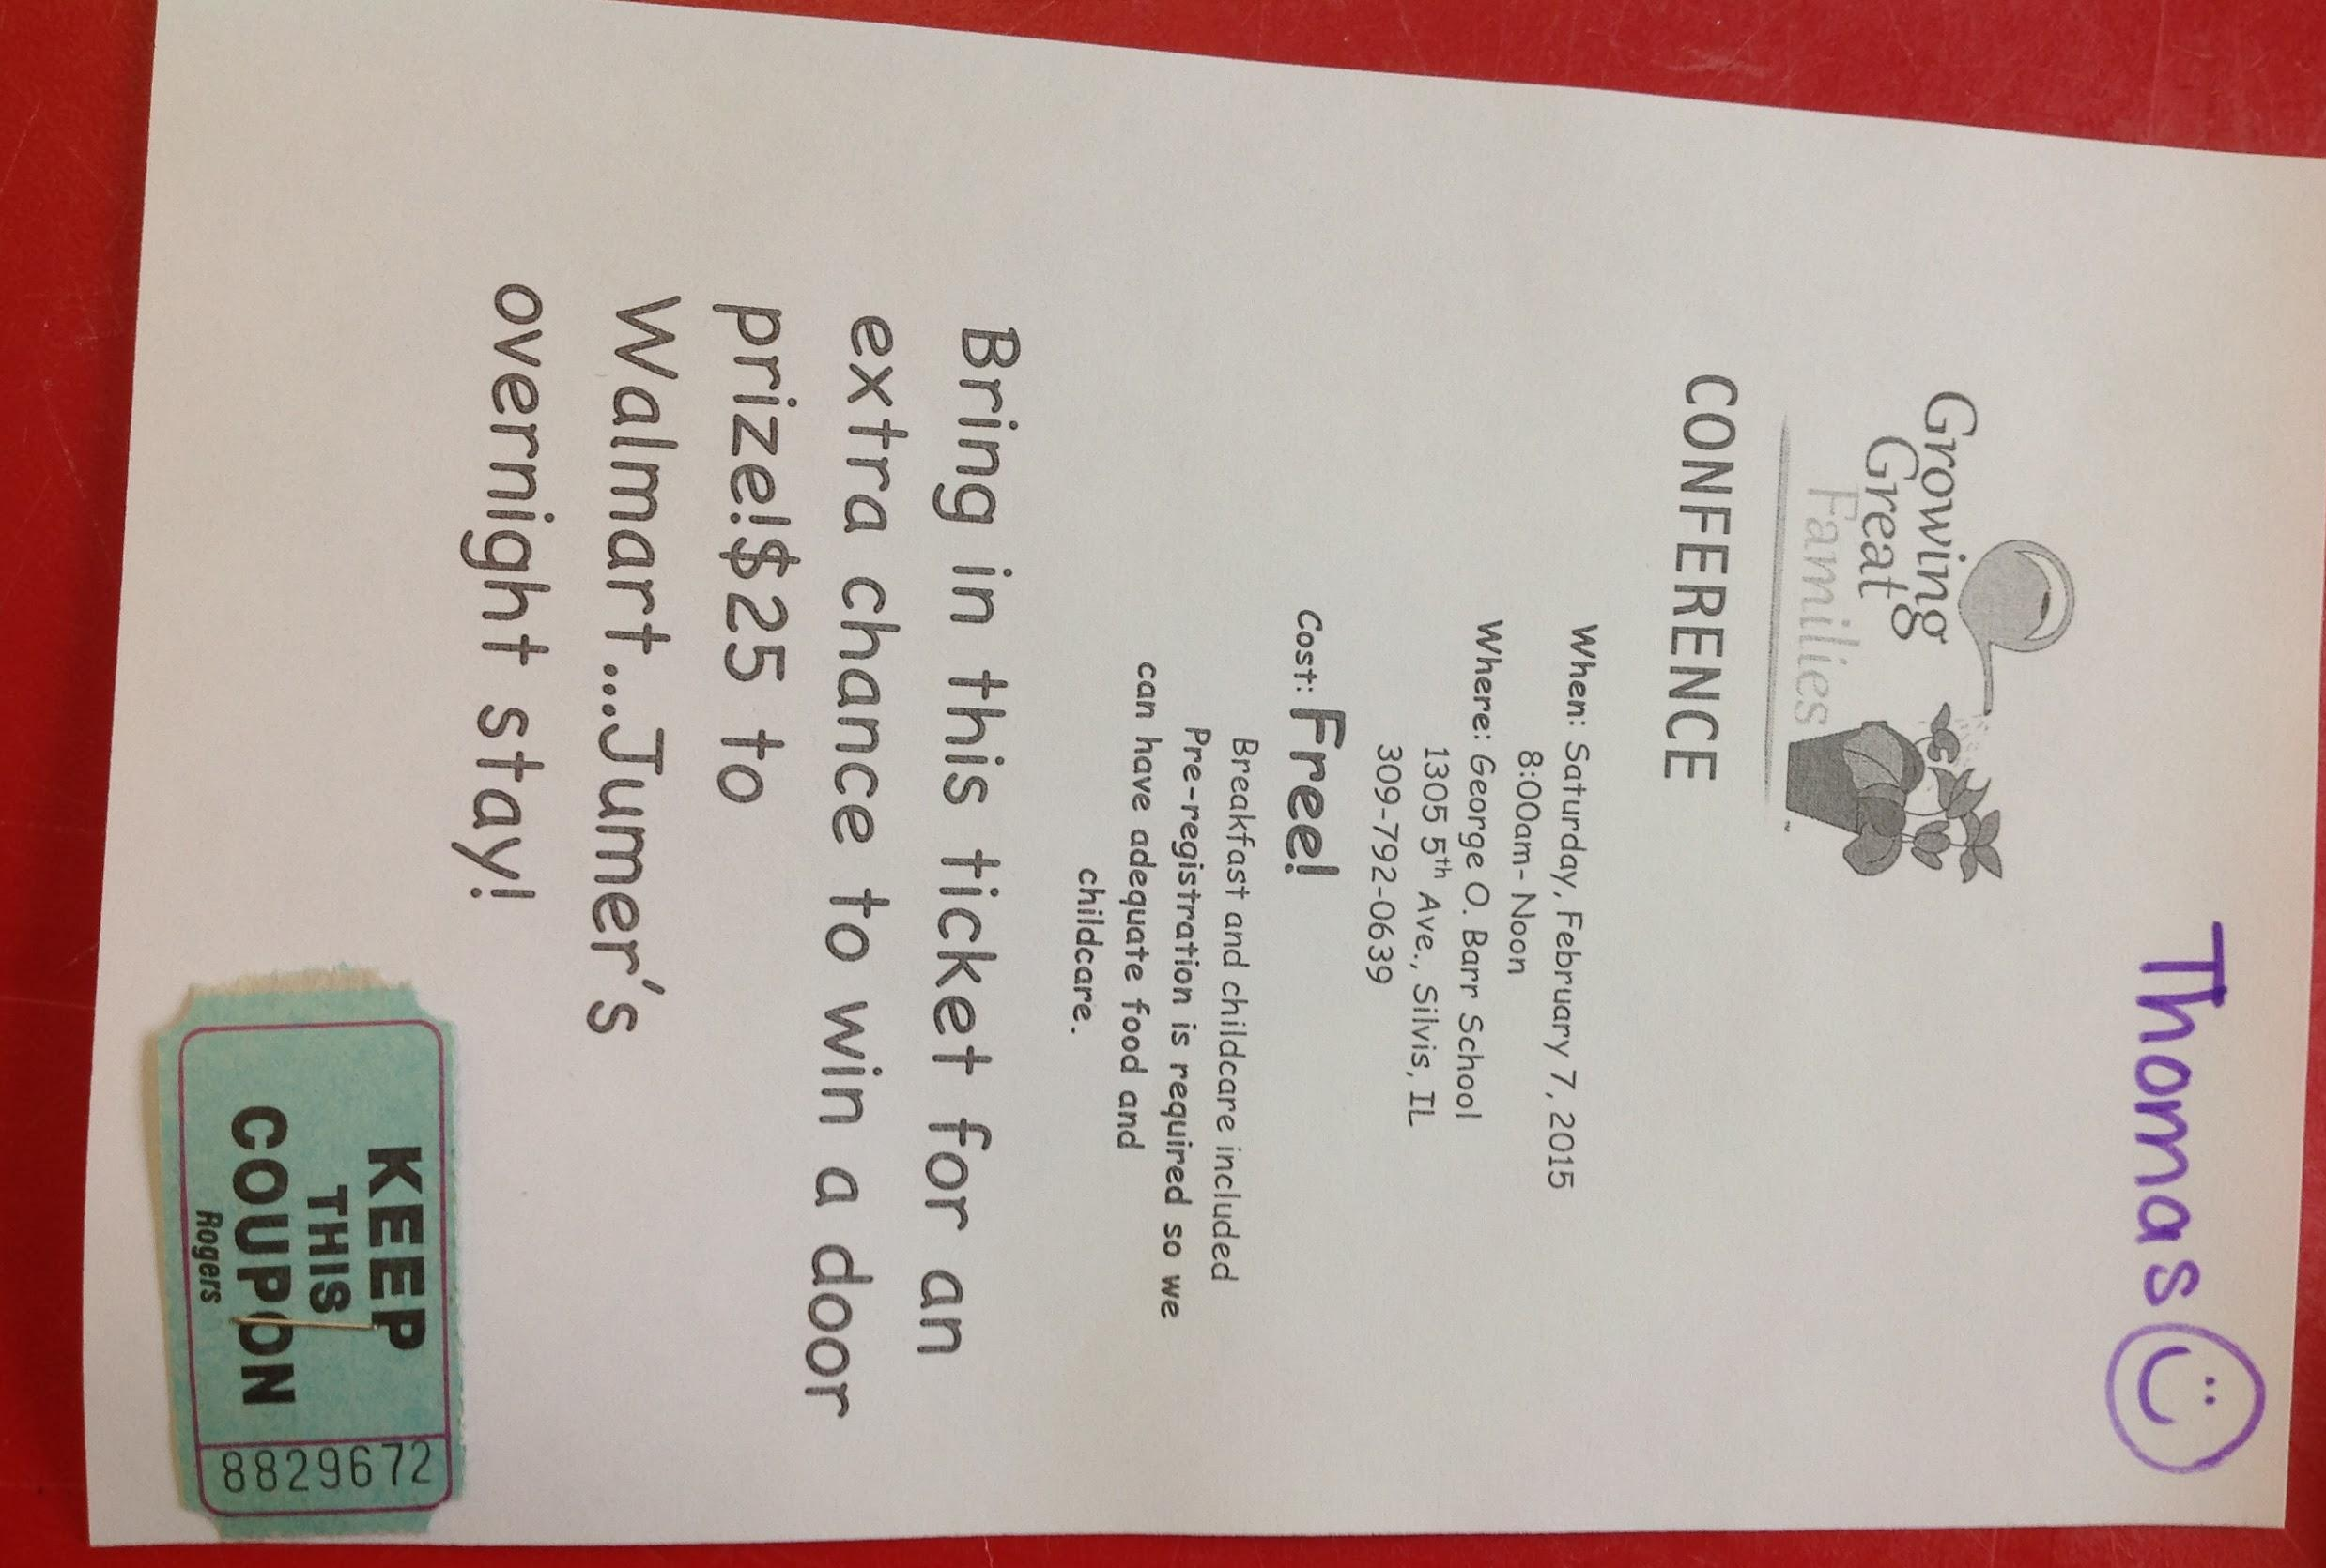
Advertising
How?
Get creative
Gimmicks...
Door Prizes

Slide 14
Food and Child Care
Breakfast
Snack
Activities
Snack
Consideration of age variance

Slide 15
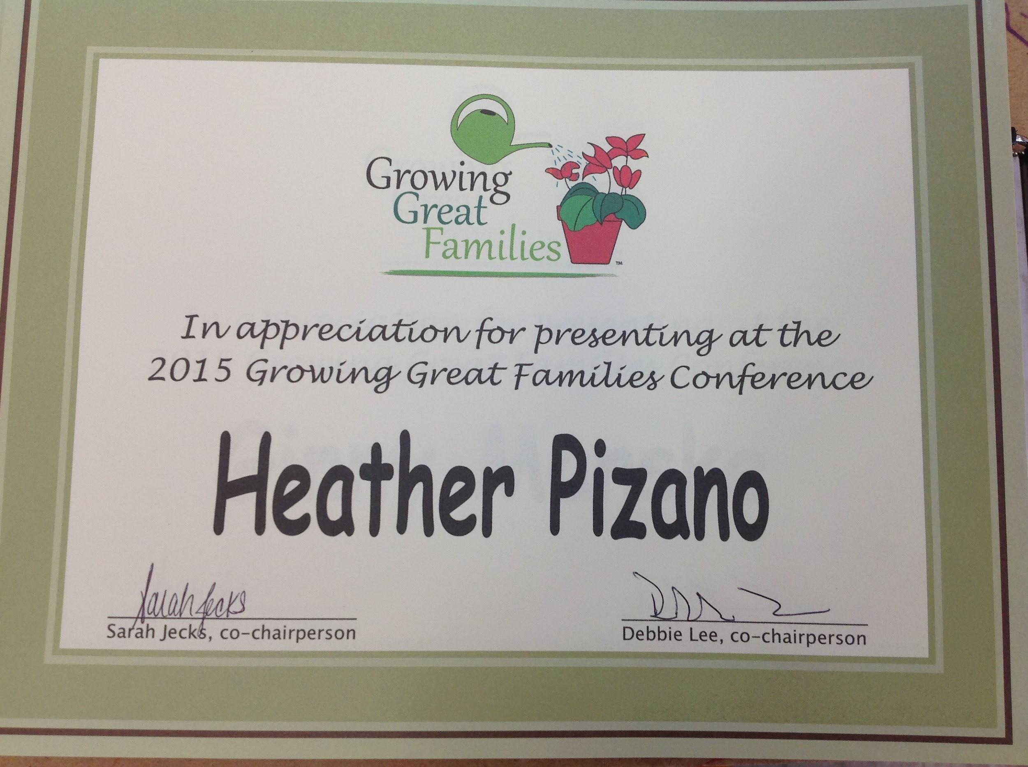
Conference Day!
Great Workshops ? ✓
Food? ✓
Child Care? ✓
Volunteers? ✓
Attendees??

Slide 16
Looking Ahead to Next Year…...
Tables to advertise libraries and various agencies
Assign subcommittees within conference committee (e.g. Publicity, Food, Child Care)
Fundraise and get more sponsors
Begin conference planning 9 months in advance

Slide 17
Visit our Website for Handouts!

Slide 18
Thank you!
Dr. Debbie Lee, Ed. D.
Western IL University
DM-Lee3@wiu.edu
Sarah Jecks, M.S.Ed.
Silvis School District#34
sarah.jecks@silvis34.com

